Slide 1
The superiority of Jesus Christ
Colossians 2:1-23

Slide 2
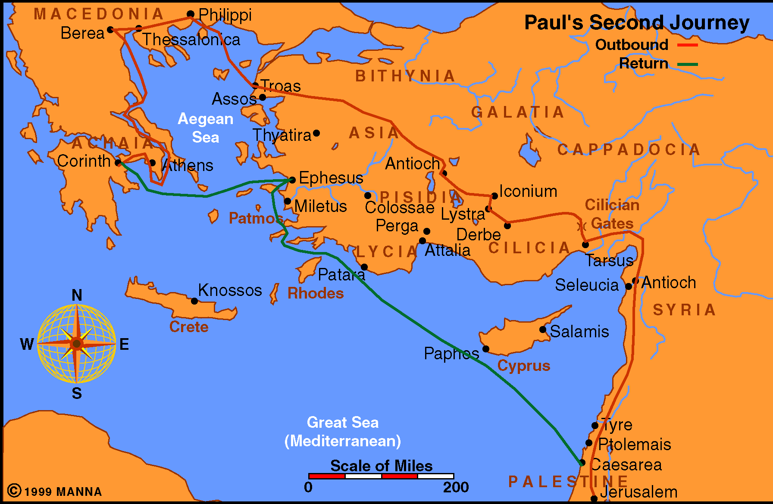
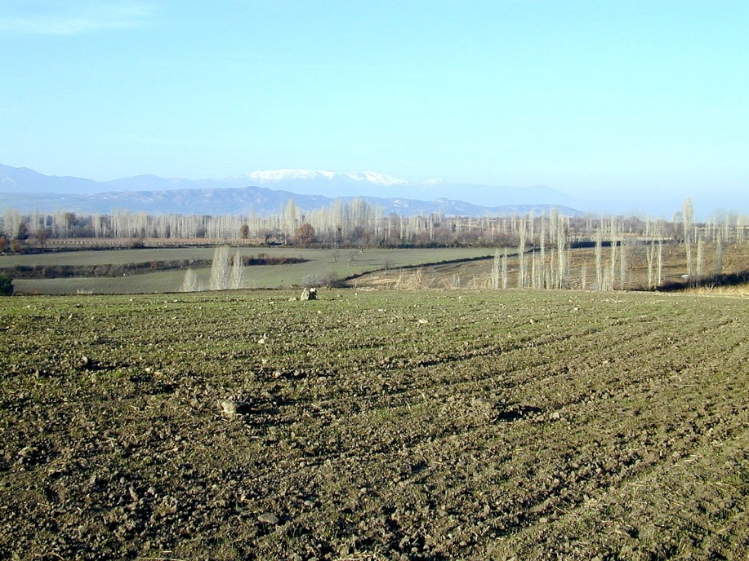

Slide 3
For I want you to know what a great conflict I have for you and those in Laodicea, and for as many as have not seen my face in the flesh, 2 that their hearts may be encouraged, being knit together in love, and attaining to all riches of the full assurance of understanding, to the knowledge of the mystery of God, both of the Father and of Christ, 3 in whom are hidden all the treasures of wisdom and knowledge. 4 Now this I say lest anyone should deceive you with persuasive words. 5 For though I am absent in the flesh, yet I am with you in spirit, rejoicing to see your good order and the steadfastness of your faith in Christ. 6 As you therefore have received Christ Jesus the Lord, so walk in Him, 7 rooted and built up in Him and established in the faith, as you have been taught, abounding in it with thanksgiving. 8 Beware lest anyone cheat you through philosophy and empty deceit, according to the tradition of men, according to the basic principles of the world, and not according to Christ. 9 For in Him dwells all the fullness of the Godhead bodily; 10 and you are complete in Him, who is the head of all principality and power. 11 In Him you were also circumcised with the circumcision made without hands, by putting off the body of the sins of the flesh, by the circumcision of Christ, 12 buried with Him in baptism, in which you also were raised with Him through faith in the working of God, who raised Him from the dead. 13 And you, being dead in your trespasses and the uncircumcision of your flesh, He has made alive together with Him, having forgiven you all trespasses, 14 having wiped out the handwriting of requirements that was against us, which was contrary to us. And He has taken it out of the way, having nailed it to the cross. 15 Having disarmed principalities and powers, He made a public spectacle of them, triumphing over them in it. 16 So let no one judge you in food or in drink, or regarding a festival or a new moon or sabbaths, 17 which are a shadow of things to come, but the substance is of Christ. 18 Let no one cheat you of your reward, taking delight in false humility and worship of angels, intruding into those things which he has not seen, vainly puffed up by his fleshly mind, 19 and not holding fast to the Head, from whom all the body, nourished and knit together by joints and ligaments, grows with the increase that is from God. 20 Therefore, if you died with Christ from the basic principles of the world, why, as though living in the world, do you subject yourselves to regulations — 21 "Do not touch, do not taste, do not handle," 22 which all concern things which perish with the using — according to the commandments and doctrines of men? 23 These things indeed have an appearance of wisdom in self-imposed religion, false humility, and neglect of the body, but are of no value against the indulgence of the flesh.

Slide 4
For I want you to know what a great conflict I have for you and those in Laodicea, and for as many as have not seen my face in the flesh, 2 that their hearts may be encouraged, being knit together in love, and attaining to all riches of the full assurance of understanding, to the knowledge of the mystery of God, both of the Father and of Christ, 3 in whom are hidden all the treasures of wisdom and knowledge. 4 Now this I say lest anyone should deceive you with persuasive words. 5 For though I am absent in the flesh, yet I am with you in spirit, rejoicing to see your good order and the steadfastness of your faith in Christ. 6 As you therefore have received Christ Jesus the Lord, so walk in Him, 7 rooted and built up in Him and established in the faith, as you have been taught, abounding in it with thanksgiving. 8 Beware lest anyone cheat you through philosophy and empty deceit, according to the tradition of men, according to the basic principles of the world, and not according to Christ. 9 For in Him dwells all the fullness of the Godhead bodily; 10 and you are complete in Him, who is the head of all principality and power. 11 In Him you were also circumcised with the circumcision made without hands, by putting off the body of the sins of the flesh, by the circumcision of Christ, 12 buried with Him in baptism, in which you also were raised with Him through faith in the working of God, who raised Him from the dead. 13 And you, being dead in your trespasses and the uncircumcision of your flesh, He has made alive together with Him, having forgiven you all trespasses, 14 having wiped out the handwriting of requirements that was against us, which was contrary to us. And He has taken it out of the way, having nailed it to the cross. 15 Having disarmed principalities and powers, He made a public spectacle of them, triumphing over them in it. 16 So let no one judge you in food or in drink, or regarding a festival or a new moon or sabbaths, 17 which are a shadow of things to come, but the substance is of Christ. 18 Let no one cheat you of your reward, taking delight in false humility and worship of angels, intruding into those things which he has not seen, vainly puffed up by his fleshly mind, 19 and not holding fast to the Head, from whom all the body, nourished and knit together by joints and ligaments, grows with the increase that is from God. 20 Therefore, if you died with Christ from the basic principles of the world, why, as though living in the world, do you subject yourselves to regulations — 21 "Do not touch, do not taste, do not handle," 22 which all concern things which perish with the using — according to the commandments and doctrines of men? 23 These things indeed have an appearance of wisdom in self-imposed religion, false humility, and neglect of the body, but are of no value against the indulgence of the flesh.

Slide 5
“…persuasive words…”
“…philosophy…”
“…principality and power…”
“…things…not seen…”
“…self-imposed religion…”
“…self-deceit…”
Human Reasoning (27 SEP):
“Let Us Reason Together”
Human Philosophy (28 SEP):
“The Way of Man is Not in Himself”
Human Authorities (29 SEP):
“No Authority But From God”
Mysticism (30 SEP – Class):
“He Has Put Eternity in Their Hearts”
Human Religion (30 SEP – AM):
“God’s Character Revealed”
Noahic & Mosaic Law (30 SEP – PM):
“God’s Covenant with Man”

Slide 6
Let US Reason Together
"Come now, and let us reason together,"
Says the LORD, (Isa. 1:18)
Christ is Superior to Human Reasoning

Slide 7
The Wisdom of God and the Wisdom of Man
Lessons from the Sermon on the Mount

Slide 8
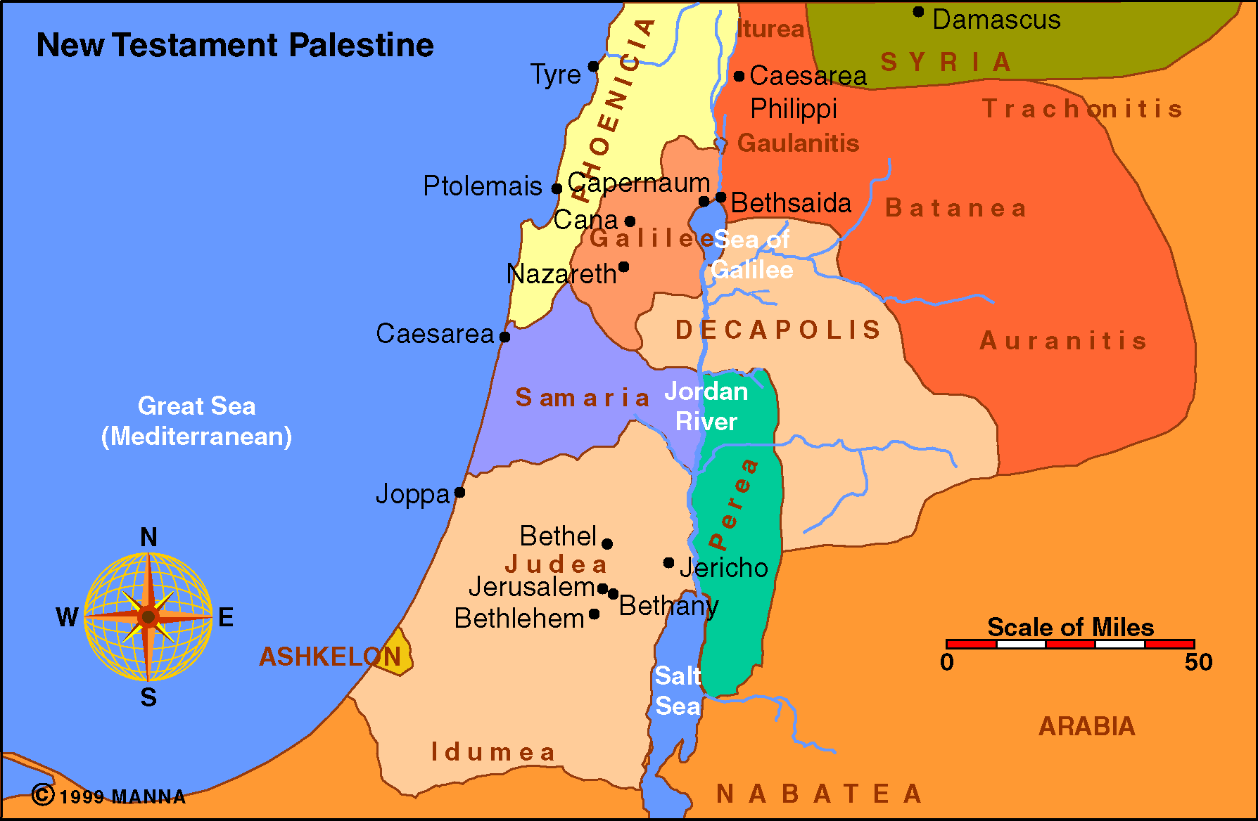

Slide 9
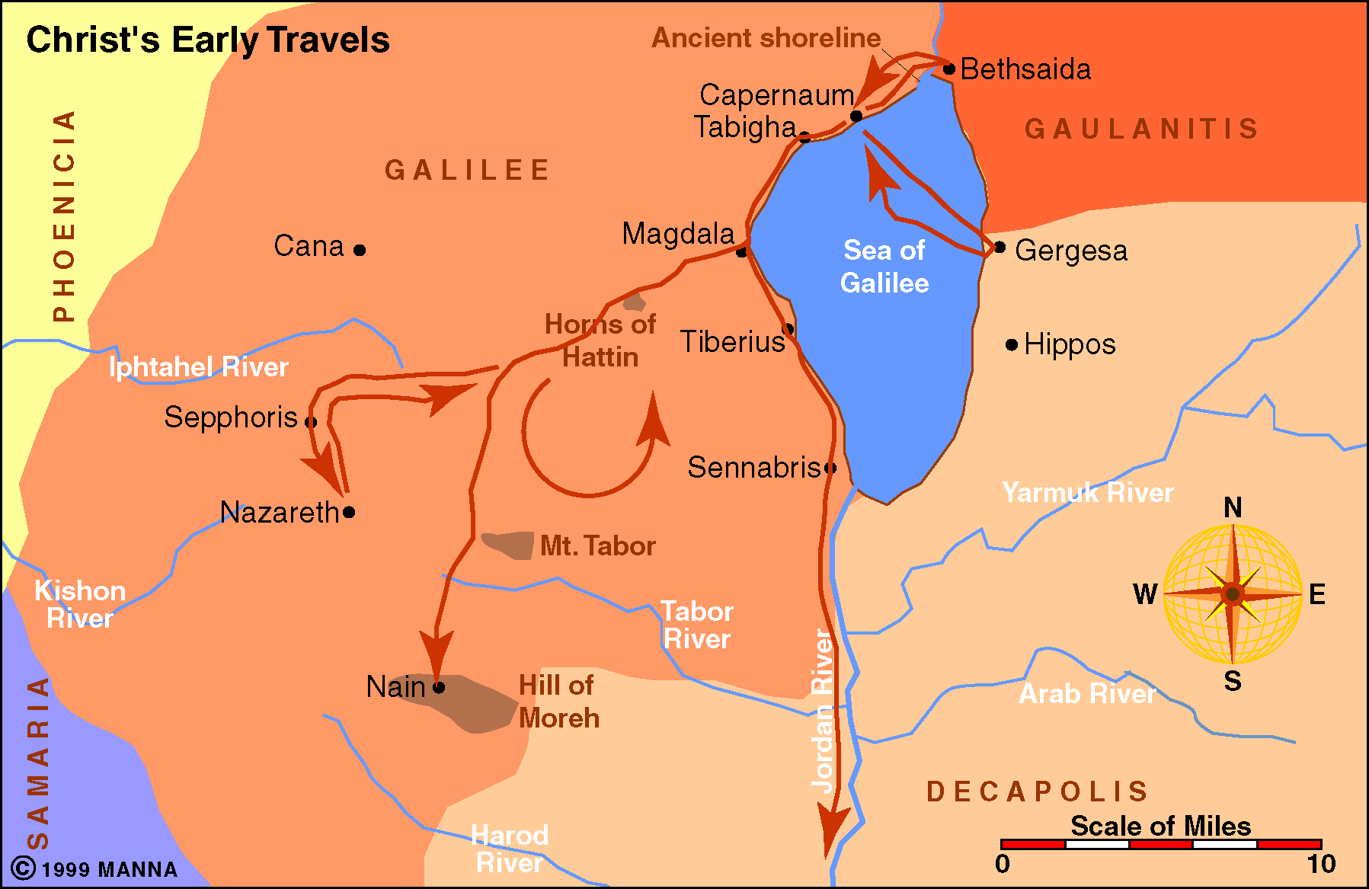

Slide 10
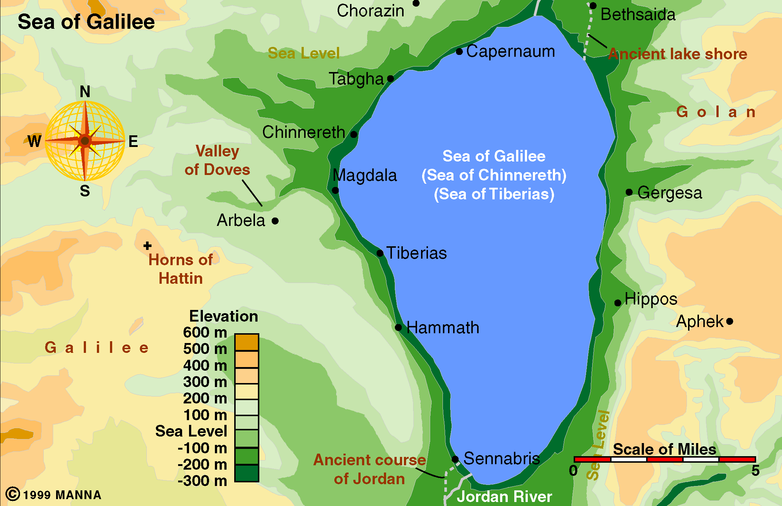

Slide 11
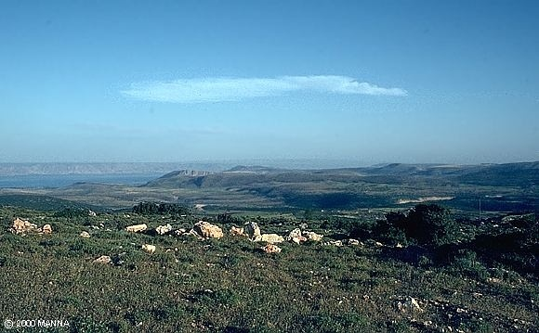

Slide 12
Outline of Matthew 5
The Beatitudes (5:3-12)
The Similitude's (5:13-16)
The fulfillment of the law (5:17-20)
The contrast between the accuracy of the Law of Moses and the Pharisaic rendition of the same (5:21-47)

Slide 13
Contrast Of The Pharisaic Rendition
“And Jesus went about all Galilee, teaching in their synagogues, preaching the gospel of the kingdom...” (Mt 4:23-24)
“Do not think that I came to destroy the Law or the Prophets. I did not come to destroy but to fulfill.” (Mt 5:17)
“For I say to you, that unless your righteousness exceeds the righteousness of the scribes and Pharisees, you will by no means enter the kingdom of heaven.” (Mt 5:20)

Slide 14
Sermon Structure
Murder and hate
Lust and adultery
Marriage is sacred and binding
Oaths
Going the second mile
Loving your enemy

Slide 15
Key Phrase
“You have heard it said…but I say to you…”

Slide 16
Murder & Hate Matthew 5:21-26
A direct quote of
Ex. 20:13
“You have heard that it was said to those of old, 'You shall not murder, and whoever murders will be in danger of the judgment.' 22 But I say to you that whoever is angry with his brother without a cause shall be in danger of the judgment. And whoever says to his brother, 'Raca!' shall be in danger of the council. But whoever says, 'You fool!' shall be in danger of hell fire.”

Slide 17
Murder & Hate – His Conclusion Matthew 5:22-26
23 Therefore if you bring your gift to the altar, and there remember that your brother has something against you, 24 leave your gift there before the altar, and go your way. First be reconciled to your brother, and then come and offer your gift. 25 Agree with your adversary quickly, while you are on the way with him, lest your adversary deliver you to the judge, the judge hand you over to the officer, and you be thrown into prison. 26 Assuredly, I say to you, you will by no means get out of there till you have paid the last penny.

Slide 18
Lust & Adultery Matthew 5:27-30
A direct quote of
Ex. 20:17
“You have heard that it was said to those of old, 'You shall not commit adultery.' 28 But I say to you that whoever looks at a woman to lust for her has already committed adultery with her in his heart.”

Slide 19
Lust & Adultery – His Conclusion Matthew 5:29-30
“If your right eye causes you to sin, pluck it out and cast it from you; for it is more profitable for you that one of your members perish, than for your whole body to be cast into hell. 30 And if your right hand causes you to sin, cut it off and cast it from you; for it is more profitable for you that one of your members perish, than for your whole body to be cast into hell.”

Slide 20
Marriage is Sacred & Binding Matthew 5:31-32
A direct quote of Deut. 24:1
“Furthermore it has been said, 'Whoever divorces his wife, let him give her a certificate of divorce.' 32 But I say to you that whoever divorces his wife for any reason except sexual immorality causes her to commit adultery; and whoever marries a woman who is divorced commits adultery.”

Slide 21
Your Word is Your Bond Matthew 33-37
Lev. 19:12
“Again you have heard that it was said to those of old, 'You shall not swear falsely, but shall perform your oaths to the Lord.' 34 But I say to you, do not swear at all: neither by heaven, for it is God's throne; 35 nor by the earth, for it is His footstool; nor by Jerusalem, for it is the city of the great King. 36 Nor shall you swear by your head, because you cannot make one hair white or black. 37 But let your 'Yes' be 'Yes,' and your 'No,' 'No.' For whatever is more than these is from the evil one.”

Slide 22
Going the Second Mile Matthew 5:38-42
Ex. 21:24
“You have heard that it was said, 'An eye for an eye and a tooth for a tooth.' 39 But I tell you not to resist an evil person. But whoever slaps you on your right cheek, turn the other to him also. 40 If anyone wants to sue you and take away your tunic, let him have your cloak also. 41 And whoever compels you to go one mile, go with him two. 42 Give to him who asks you, and from him who wants to borrow from you do not turn away.”

Slide 23
Loving Your Enemies Matthew 5:43-48
Lev. 19:18
“You have heard that it was said, 'You shall love your neighbor and hate your enemy.' 44 But I say to you, love your enemies, bless those who curse you, do good to those who hate you, and pray for those who spitefully use you and persecute you,”
Misapplication of Deut. 23:3-6

Slide 24
Loving Your Enemies - His Conclusion Matthew 5:45-48
“that you may be sons of your Father in heaven; for He makes His sun rise on the evil and on the good, and sends rain on the just and on the unjust. 46 For if you love those who love you, what reward have you? Do not even the tax collectors do the same? 47 And if you greet your brethren only, what do you do more than others? Do not even the tax collectors do so? 48 Therefore you shall be perfect, just as your Father in heaven is perfect.”

Slide 25
Putting It All Together
Is Jesus negating the Law of Moses, thereby superseding the law and setting in place the law of His gospel?
Is Jesus correcting the manner in which the Jews, in particular the Pharisees, had interpreted, understood and applied the Law of Moses?
Or both?

Slide 26
Contrast Of The Pharisaic Rendition
“And Jesus went about all Galilee, teaching in their synagogues, preaching the gospel of the kingdom...” (Mt 4:23-24)
“Do not think that I came to destroy the Law or the Prophets. I did not come to destroy but to fulfill.” (Mt 5:17)
“For I say to you, that unless your righteousness exceeds the righteousness of the scribes and Pharisees, you will by no means enter the kingdom of heaven.” (Mt 5:20)

Slide 27
What Did Jesus Really Say?
“You have heard it said” | “But I say to you”
Don’t murder | Don’t hate
Don’t commit adultery | Don’t lust
Give a certificate of divorce | Don’t divorce
Perform your oaths | Don’t swear
“An eye for an eye” | Go the second mile
Love neighbor, hate enemy | Love all

